Slide 1
Introduction to JavaScript
Variables and Functions
Week 3
ReDI

Slide 2

Agenda
Homework Review
Introduction to JavaScript
Data types and variables
Functions

Slide 3
Homework Review
Read Article on CSS A guide for future consultation about flexbox
Watch Video about flexbox Introduction to JavaScript

Slide 4

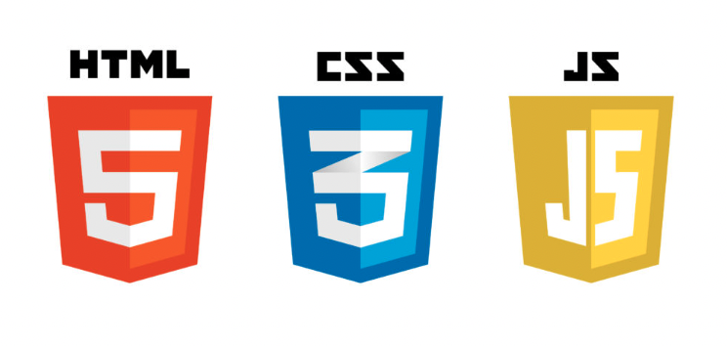
The Perfect Setup
index.html
styles.css
script.js

Slide 5
index.html
<!DOCTYPE html>
<html lang="en">
<head>
<meta charset="UTF-8">
<meta name="viewport" content="width=device-width, initial-scale=1.0">
<link rel="stylesheet" type="text/css" href="styles.css">
<title>JavaScript Funsies</title>
</head>
<body>
<h1>JavaScript - Variables and Functions</h1>
</body>
<script src="script.js"></script>
</html>

Slide 6
Introduction to JS
JavaScript is a lightweight programming language that developers commonly use to create more dynamic interactions when developing web pages, applications, servers, and or even games. Developers generally use JavaScript alongside HTML and CSS.
JavaScript manages user interaction, something that CSS cannot do by itself.

Slide 7
Browser
Javascript interacts with the browser.
What can you use in the browser?
Console
Document
Screen
Window
Location
… and others
Notes:
https://www.w3schools.com/js/js_ex_browser.asp

Slide 8
Console
The console is really helpful for developers to debug our code. Debugging is the act of removing a bug in the code.
A bug is basically an error in the code.
How can you use the console?

Slide 9
Console
Open your script.js file in Visual Studio Code, type the following line and save the file:
console.log("Hello world");

Slide 10
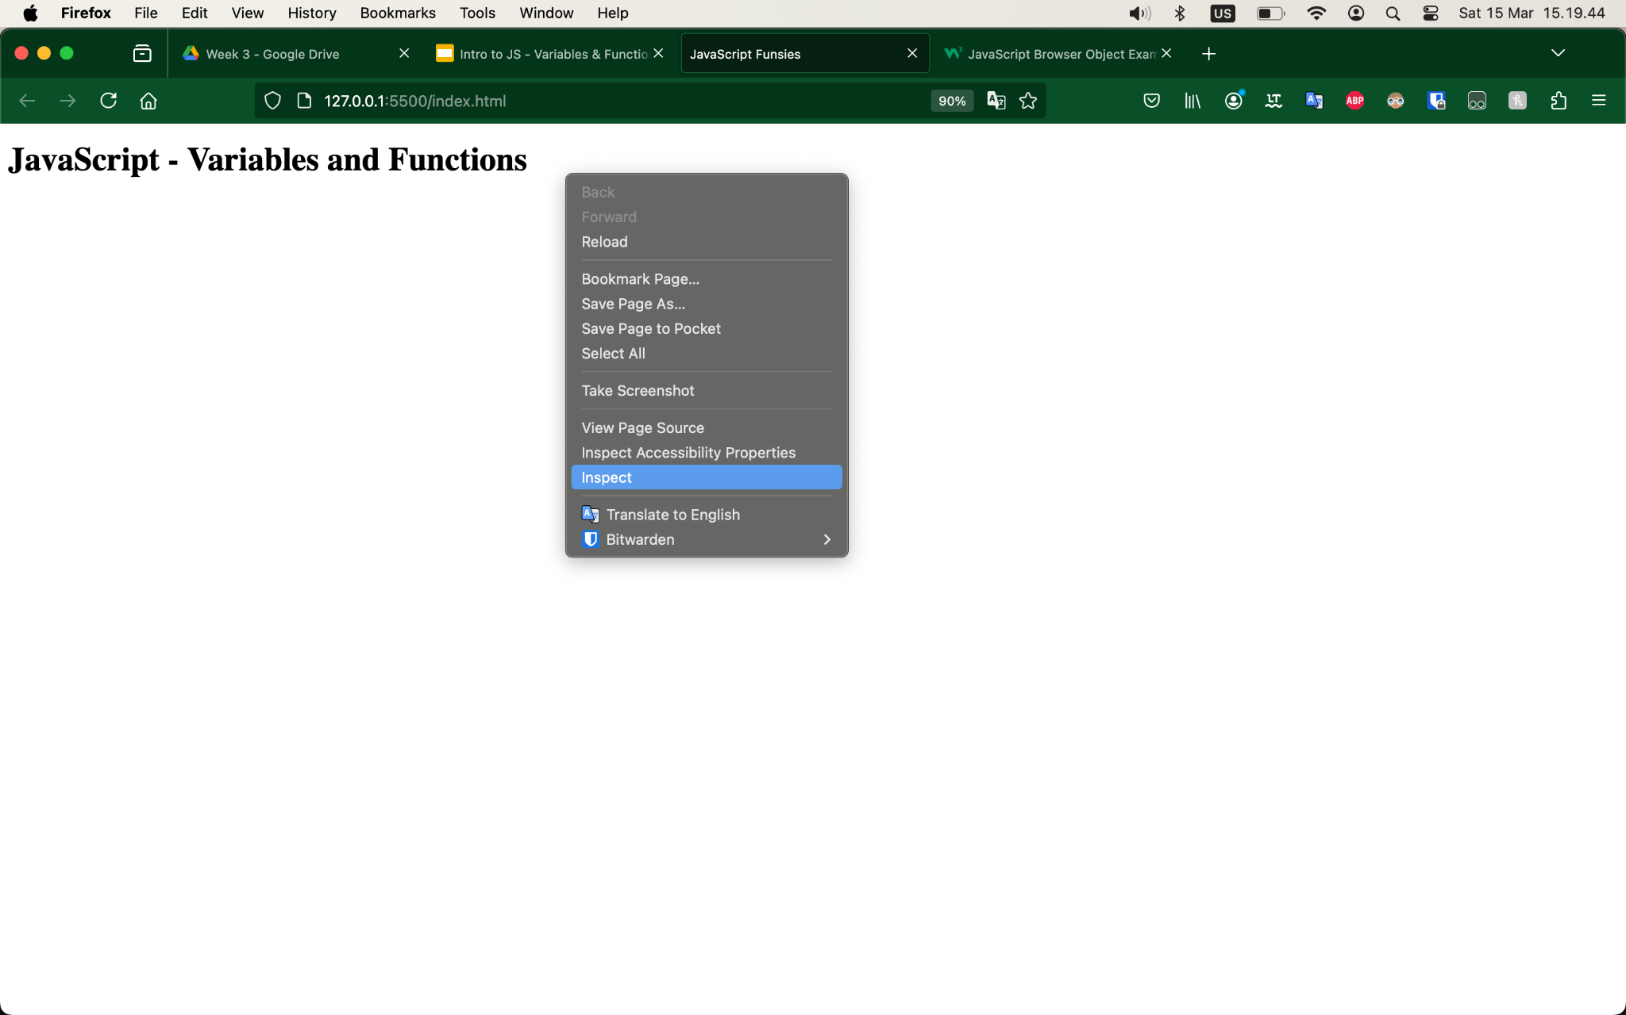
Console

Slide 11
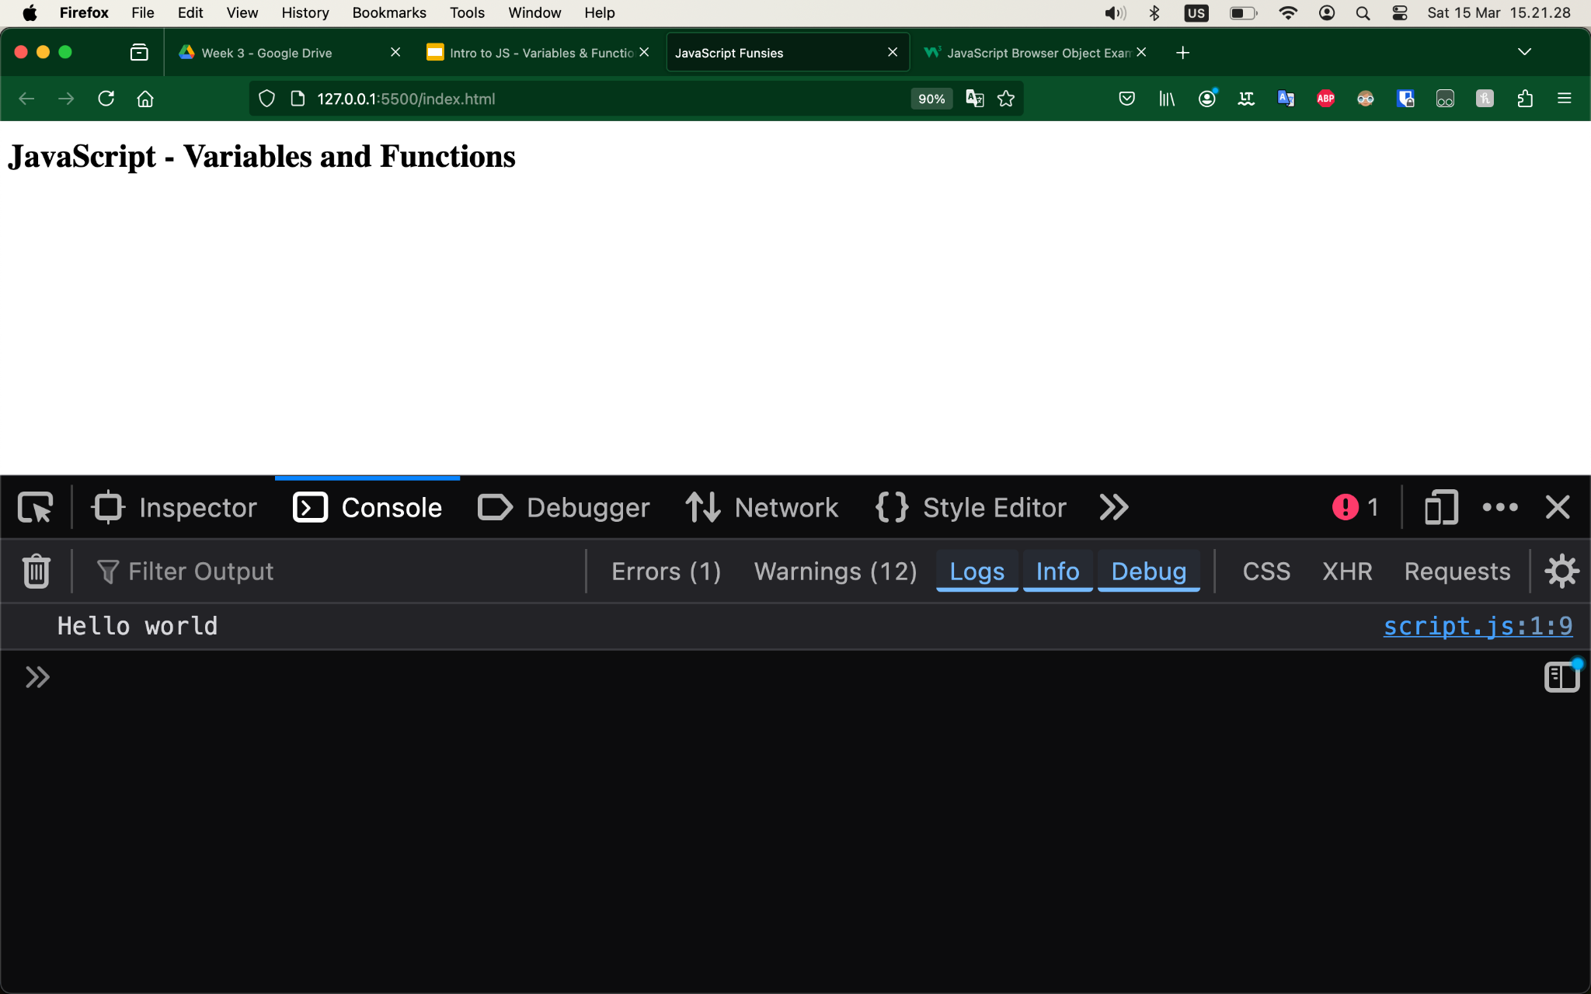
Console

Slide 12
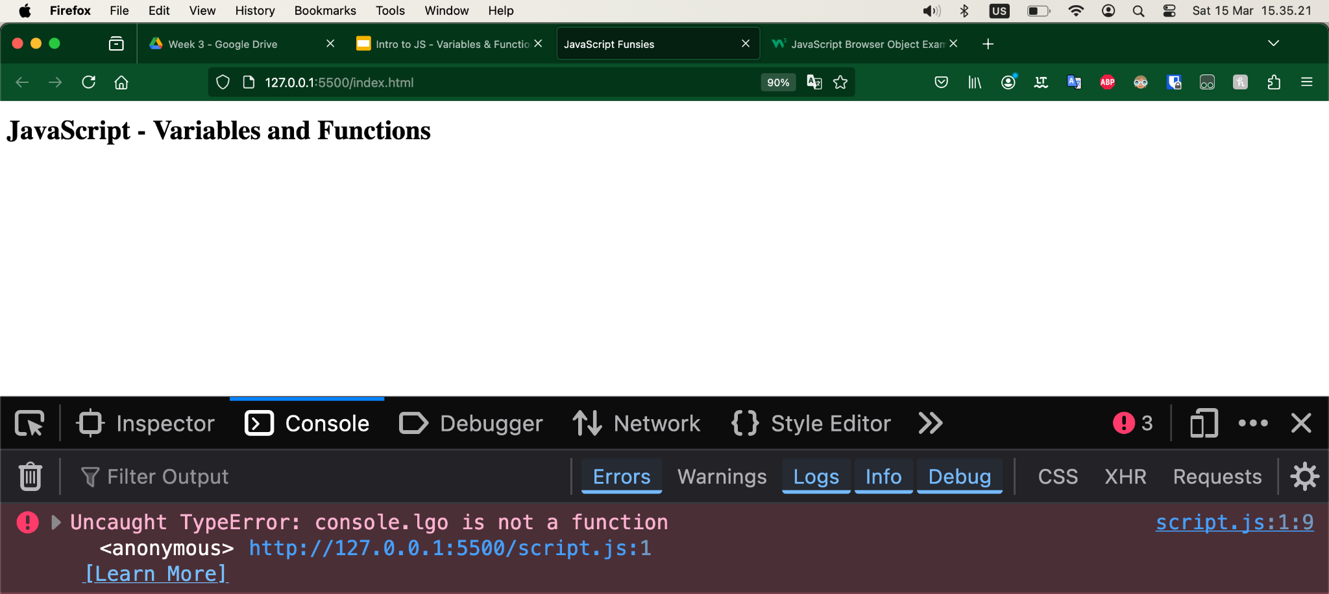
Console
console.lgo("Hello world");

Slide 13
Document
Within a browser, JavaScript doesn't do anything by itself. You run JavaScript from inside your HTML web pages. To call JavaScript code from within HTML, you need the <script> element.
<!DOCTYPE html>
<html lang="en">
<head>
<meta charset="UTF-8">
<meta name="viewport" content="width=device-width, initial-scale=1.0">
<link rel="stylesheet" type="text/css" href="styles.css">
<title>JavaScript Funsies</title>
</head>
<body>
<h1>JavaScript - Variables and Functions</h1>
</body>
<script src="script.js"></script>
</html>

Slide 14
Code Example
const name = "Lukas";
let age = 30;
age = 30 + 1;
console.log("Age: " + age);
//Accessing the HTML element <h1> with the id "heading"
const documentHeading = document.querySelector("#heading");
if (age > 30){
documentHeading.textContent = "Old Lukas";
}
else {
documentHeading.textContent = "Young Lukas";
}

Slide 15
JS - Basic Concepts
Code is executed sequentially from the top to the bottom and left to right
There are some reserved keywords that are part of the language such as: console, let, const, if, else …
Comments
// is used to comment out one single line
/* */ is used to comment out multiple sequential lines

Slide 16

Break
10-15 minutes to get up and relax

Slide 17
Data types
Primitive values
Number - Represents numeric values, inc. integers and decimals,
e.g. 23, -5, 1.05, 0.005
String - Represents sequences of characters, enclosed in quotes (single or double), e.g. “A text”, ‘Another text’, “23”, ‘0.005’
Boolean - Represents logical values - true/false
Undefined - Represent the absence of a value
Null - Represent exactly one value - null
Symbol - Represents a unique and immutable identifier
BigInt - Represent large integers, e.g. 12345678901234567890n
Notes:
Nice read but maybe a bit complex: https://ui.dev/primitive-vs-reference-values-in-javascript

Slide 18
Data types
Reference values (we will cover them later)
Object {name: ‘Lukas’, age: 30}
Array [1, 2, 3, 4]
Function () => ({})
Notes:
Nice read but maybe a bit complex: https://ui.dev/primitive-vs-reference-values-in-javascript

Slide 19
Variables
Variables are containers for storing data.
They “hold” the data value which can be changed anytime.
var myAge = 37;
var productPrice = 199;
var initialState = { };
Notes:
Examples and explanations for variables in js: https://www.w3schools.com/js/js_variables.asp

Slide 20
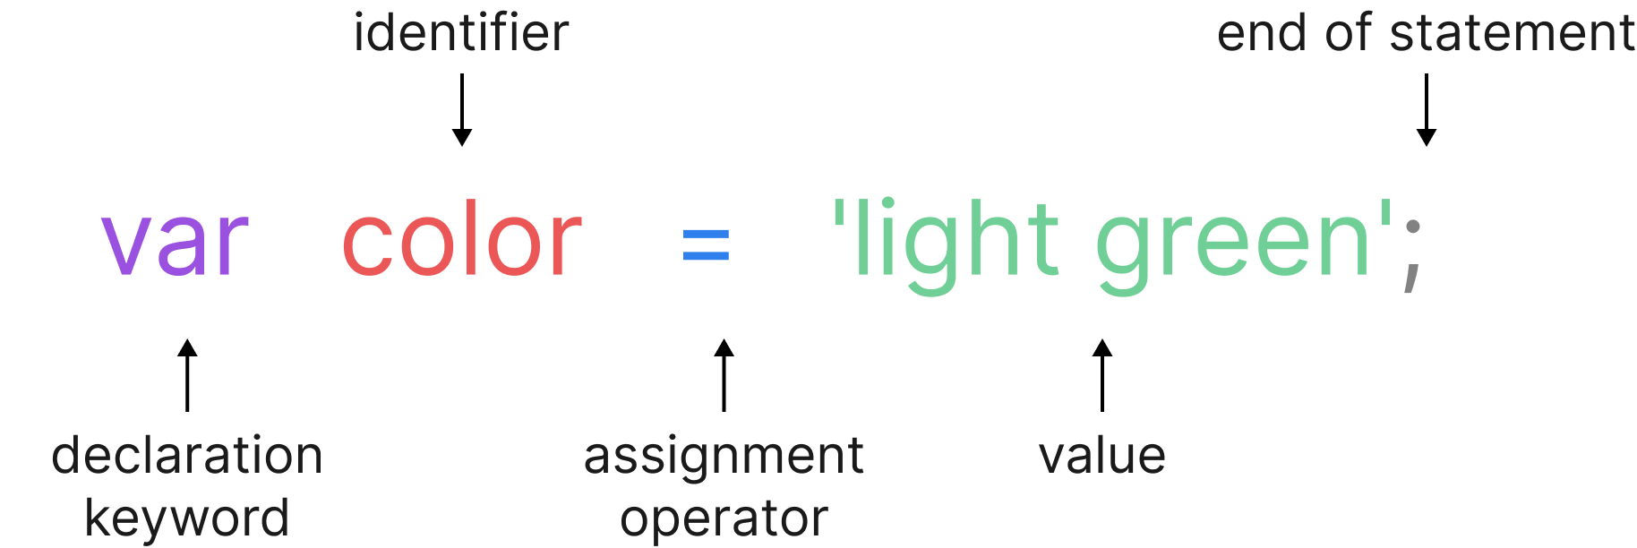
Variables
JavaScript uses reserved keyword var to declare a variable. A variable must have a unique name. You can assign a value to a variable using equal to (=) operator when you declare it or before using it.
Notes:
Examples and explanations for variables in js: https://www.w3schools.com/js/js_variables.asp

Slide 21
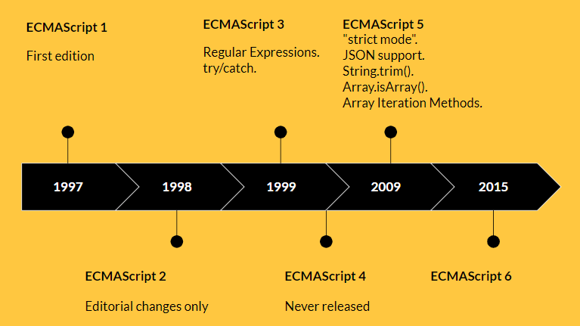
ES5 vs ES6
ECMAScript is a standard specification of the language and the syntax. In ES6 some breaking new changes were introduced:
Variable declaration
Arrow functions

Slide 22
ES6 Variables
The reserved keyword var is not used anymore - instead we use:
let - can be reassigned and modified
const: is constant, so cannot be reassigned nor modified

Slide 23
ES6 Variables
const name = "Lukas";
let age = 30;

Slide 24
Declaration vs Initialization
let message;
message = "Hello World!";
let age = 30;
age = age + 1; //age = 30 + 1;
let address = 'Cylindervej';
address = 'Dieselvej';
const cprNumber = '123456-1234'; //Cannot change

Slide 25
Variable names
Variable names (or identifiers) have to be unique and can be short (like x and y) or have more descriptive names (age, cprNumber). If a variable name consists of more than one word we usually use camelCase (uppercase for the first letter of the next word: cprNumber).

Slide 26
Variable names - rules
Names can contain letters, digits and underscores.
Names must begin with a letter.
Names are case sensitive.
Reserved keywords cannot be used.
No spaces are allowed.

Slide 27
Exercise
Create 2 variables of type number/integer.
In a third variable try adding the numbers together.
Output the result.
Create 2 variables of type string (text).
Try creating a third variable that add them together.
Output the result.
Create 2 variables: a number and a string. Add them together. → What do you expect to happen? What happened?
Try re-initializing a const variable → What happened? Anything in the console? Try the same with let.
What is the difference between console.log(myName) and console.log(‘myName’) when both would run without errors?
Notes:
Make a cup of tea
get water
from: tap || bottled || well
get tea
from: cupboard || supermarket
if loose tea, put tea in filter
get cup
from: cupboard || store
boil water
in: kettle || (pot && (stove || fire))
wait for water to cool slightly
<if white or green tea> until water is 80 degrees celsius
<if black tea> don’t wait (needs 100 degrees celsius)
put tea filter into cup
poor water into cup
wait
depending on the kind of tea: 1-10 min.
remove tea filter from cup
drink tea
Cook bowl of rice
get water
from: tap || bottled || well
get rice
from: cupboard || supermarket
<if rice cooker is available>
add rice and water into cooker
turn on cooker
<else>
get pot
from: cupboard || store
put rice into pot
add water
amount dependent on type of rice
boil rice
on: stove || fire
time: dependent on the type of rice
remove pot from warmth
wait
time: dependent on the type of rice and cooking method
get bowl
from: cupboard || store
poor rice into bowl
eat the rice
Access the internet from a computer
(prerequisite: functioning computer is available)
get computer
turn on computer
<if password is required> log into computer
turn on wifi
connect to wifi
<if password is required> type in wifi password
open prefered browser
<if browser has separate search bar>
type search string into search bar
<else>
type search string into address bar
press enter
feel the surfing
Start a car
(prerequisite: valid driver’s license)
get the car key
<if car doesn’t have automatic unlocking>
<if car has central lock> click open button on car key
<if car has manual lock> put key into car door and turn to unlock
open car door
sit down at the driver’s seat
close the car door
put on seat belt
<if car has a stick>
put car in first/reverse gear
step on the clutch and hold it down
<else>
put car in drive/reverse mode
<if car is NOT keyless>
put car key into keyhole
turn car key to start the engine
<else>
press turn-on button
<if car has a stick>
slowly lift the clutch AND slowly step on the speeder
<else>
slowly step on the speeder
start driving

Slide 28
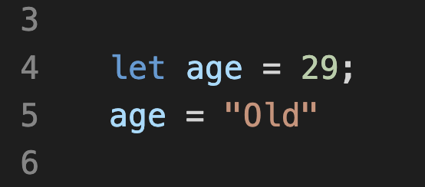
Type conversion
Variables can be changed from one data type to another by many means, such as reassignment, function and even automatically by Javascript.

Slide 29
Break
10-15 minutes to get up and relax

Slide 30
Functions
When developing an application, you often need to perform the same action in many places.
For example, you may want to show a message whenever an error occurs.
To avoid repeating the same code at different places, you can use a function to wrap that code and reuse it.

Slide 31
Functions
There are 3 main steps to use functions:
Declare the function
Pass arguments(parameters)
Call the function

Slide 32
Functions
Declaring a function
To declare a function, you use the function keyword, followed by the function name, a list of arguments(if any) and the function body:
function sayHiToUser()
{
alert("Hi");
}

Slide 33
Functions
Declaring a function
The function name must be a valid JavaScript identifier. By convention, the function names are in camelCase and start with verbs, e.g. getData(), fetchContents(), isValid(), etc.
A function can accept zero, one, or multiple arguments(parameters). In the case of multiple arguments, you need to use a comma to separate them.

Slide 34
Functions
Declaring a function
The following declares a function sayHiToUser() that takes no argument:
function sayHiToUser()
{
alert("Hi");
}

Slide 35
Functions
Declaring a function
Inside the function body, you can write the code to implement an action. For example, the following sayHiToUser() function simply shows a message as an alert:
function sayHiToUser()
{
alert("Hi");
}

Slide 36
Functions
Passing arguments
The following declares a function named square that takes one argument:
function square(number)
{
number * number;
}

Slide 37
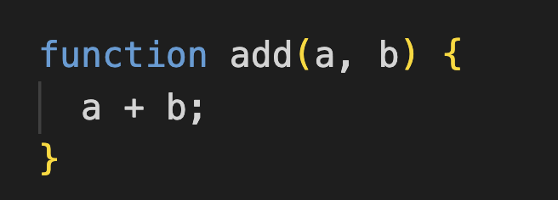
Functions
Passing arguments
And the following declares a function named add that takes two arguments:

Slide 38
Functions
Calling a function!
To call a function, you use its name followed by arguments enclosing in parentheses like this:
sayHiToUser();

Slide 39
Functions
Calling a function!
If the function is expecting some arguments we need to pass them when we call it:
square(2); /* or */ add(2, 3);

Slide 40
Functions
Using a return value
One of the purposes of functions is to reuse the outcome of running some code.
Every function in JavaScript implicitly returns undefined unless you specify a return value
function square(number)
{
return number * number;
}

Slide 41
Functions
Using a return value
function square(number)
{
return number * number;
}
let squaredNumber = square(2);
console.log("Squared number: " + squaredNumber);

Slide 42
Exercise
20 minutes
Write a function named calculateDogAge that:
1. Takes 1 argument: your dog's age.
2. Calculates your dog's age based on the conversion rate of 1 human year to 7 dog years.
3. Outputs the result
4. Use the result from the function and create an alert with the human age of your puppy. Display the result to the screen like so: "Your doggie is XX years old in dog years!"
Notes:
Make a cup of tea
get water
from: tap || bottled || well
get tea
from: cupboard || supermarket
if loose tea, put tea in filter
get cup
from: cupboard || store
boil water
in: kettle || (pot && (stove || fire))
wait for water to cool slightly
<if white or green tea> until water is 80 degrees celsius
<if black tea> don’t wait (needs 100 degrees celsius)
put tea filter into cup
poor water into cup
wait
depending on the kind of tea: 1-10 min.
remove tea filter from cup
drink tea
Cook bowl of rice
get water
from: tap || bottled || well
get rice
from: cupboard || supermarket
<if rice cooker is available>
add rice and water into cooker
turn on cooker
<else>
get pot
from: cupboard || store
put rice into pot
add water
amount dependent on type of rice
boil rice
on: stove || fire
time: dependent on the type of rice
remove pot from warmth
wait
time: dependent on the type of rice and cooking method
get bowl
from: cupboard || store
poor rice into bowl
eat the rice
Access the internet from a computer
(prerequisite: functioning computer is available)
get computer
turn on computer
<if password is required> log into computer
turn on wifi
connect to wifi
<if password is required> type in wifi password
open prefered browser
<if browser has separate search bar>
type search string into search bar
<else>
type search string into address bar
press enter
feel the surfing
Start a car
(prerequisite: valid driver’s license)
get the car key
<if car doesn’t have automatic unlocking>
<if car has central lock> click open button on car key
<if car has manual lock> put key into car door and turn to unlock
open car door
sit down at the driver’s seat
close the car door
put on seat belt
<if car has a stick>
put car in first/reverse gear
step on the clutch and hold it down
<else>
put car in drive/reverse mode
<if car is NOT keyless>
put car key into keyhole
turn car key to start the engine
<else>
press turn-on button
<if car has a stick>
slowly lift the clutch AND slowly step on the speeder
<else>
slowly step on the speeder
start driving

Slide 43
Exercise
20 minutes
B. Write a function named moneyToSpendInCoffeUntil80 that:
1. Takes 2 arguments: your current age and price for a cup of coffee 2. Calculates how much money you will spend if you drink one cup of coffee per day until you are 80 years old.
Notes:
Make a cup of tea
get water
from: tap || bottled || well
get tea
from: cupboard || supermarket
if loose tea, put tea in filter
get cup
from: cupboard || store
boil water
in: kettle || (pot && (stove || fire))
wait for water to cool slightly
<if white or green tea> until water is 80 degrees celsius
<if black tea> don’t wait (needs 100 degrees celsius)
put tea filter into cup
poor water into cup
wait
depending on the kind of tea: 1-10 min.
remove tea filter from cup
drink tea
Cook bowl of rice
get water
from: tap || bottled || well
get rice
from: cupboard || supermarket
<if rice cooker is available>
add rice and water into cooker
turn on cooker
<else>
get pot
from: cupboard || store
put rice into pot
add water
amount dependent on type of rice
boil rice
on: stove || fire
time: dependent on the type of rice
remove pot from warmth
wait
time: dependent on the type of rice and cooking method
get bowl
from: cupboard || store
poor rice into bowl
eat the rice
Access the internet from a computer
(prerequisite: functioning computer is available)
get computer
turn on computer
<if password is required> log into computer
turn on wifi
connect to wifi
<if password is required> type in wifi password
open prefered browser
<if browser has separate search bar>
type search string into search bar
<else>
type search string into address bar
press enter
feel the surfing
Start a car
(prerequisite: valid driver’s license)
get the car key
<if car doesn’t have automatic unlocking>
<if car has central lock> click open button on car key
<if car has manual lock> put key into car door and turn to unlock
open car door
sit down at the driver’s seat
close the car door
put on seat belt
<if car has a stick>
put car in first/reverse gear
step on the clutch and hold it down
<else>
put car in drive/reverse mode
<if car is NOT keyless>
put car key into keyhole
turn car key to start the engine
<else>
press turn-on button
<if car has a stick>
slowly lift the clutch AND slowly step on the speeder
<else>
slowly step on the speeder
start driving

Slide 44
Homework
You and your family are busy today and don't have time to cook for dinner. You’ve decided to order some food, but your partner and your children like different restaurants.
Write a function that takes 3 arguments: name of the restaurant, food and amount.
Outputs the result to your console with the message : You are ordering {amount} {food} from {name of the restaurant}
Call the function 3 times with different argument values

